Slide 1

Color and Text Web Accessibility
Josh Forbes, Sterling Davis, Jordan Norris
Research II
December 9 2025

Slide 2

Introduction and Background
Color choice plays an important role in user interface design, and a bad choice can lead to a web page that is not readable or accessible especially for those with visual impairments
Our goal is to help fix this problem by developing a tool that gives the users the ability to choose their own colors for web pages that are not readable
With over a billion websites in the world, making sure they are accessible is an important task not only as developers but as stewards

Slide 3

Literature
Review

Slide 4
Literature Review Summary
Website Accessibility is important especially due to the increase of internet users every single year.
The world wide web is a staple of communication in our day and age
The most popular web accessibility standards are the WCAG (web content accessibility guidelines)
Guidelines each have a 1x-3x ‘A’ rating
Currently known tools are frequently inaccurate

Slide 5
Literature Review Gaps
Many tools exists for developers to use but not for the users
These tools are not easy to use and even with these tools there are still millions of web pages that violate the WCAG guidelines
Many of the tools are for detection only and don’t give practical suggestions to fix the errors
Developers are more likely to focus on the aesthetics of the web page rather than how accessible the web page is

Slide 6
Methodology

Slide 7
Methodology Goal
Design a browser extension that allows users to create custom accessibility modes (color + text adjustments)
Users can modify webpage colors, text size, and element contrast
Puts accessibility control into the hands of the user

Slide 8
Methodology Tools
The browser extension was created using Google Chrome’s extension API
WCAG Guidelines as a baseline metric
Cloudflare for site hosting
Bad testing web page (hosted on cloudflare)
WAccess
Google Chrome dev tool (specifically the inspector)
Let’s get color blind filter (for non color blind testers)
Git Lab and VS Code for programming and sharing

Slide 9
Methodology Data Collection
User testing was used for our data collection
We designed a basic bad web page for users to test
A colorblind filter was placed over the web page so users could simulate the perspective of someone with visual impairments
We also documented which colorblind filter each user used
Users would rate the web page readability and accessibility on a scale of 1-10
Users would then have 10 minutes to use our tool to improve the web pages accessibility
Users would finally rate the web page again using the same metrics

Slide 10
Methodology Process Design
Proof of Concept -> Simple extension altering basic tags (p, h1, background-color)
Persistence -> Save and load user-defined modes
Element Selection -> Hover + select specific elements to customize
Full Extension Setup -> Ensure stable functionality and UI
Evaluation Phase -> Test WCAG improvement + gather user feedback

Slide 11
Demonstration

Slide 12
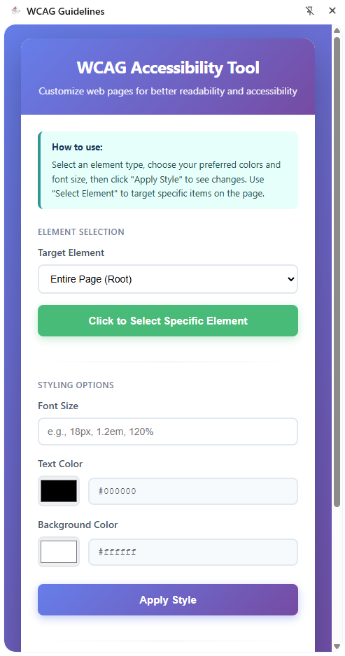
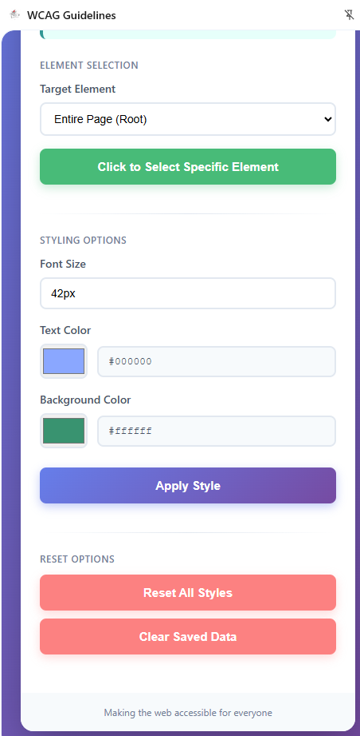
Methodology Process Design

Slide 13
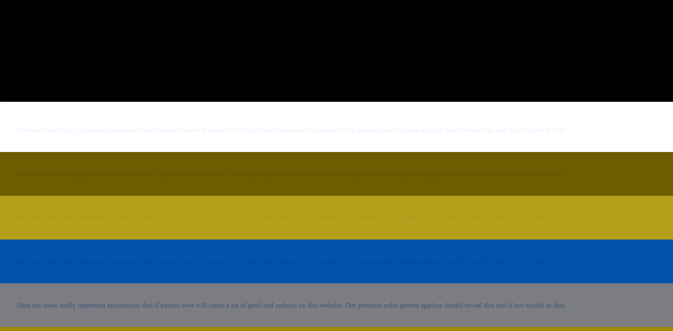
Methodology Process Design
*Protanomaly (Red) Filter applied

Slide 14
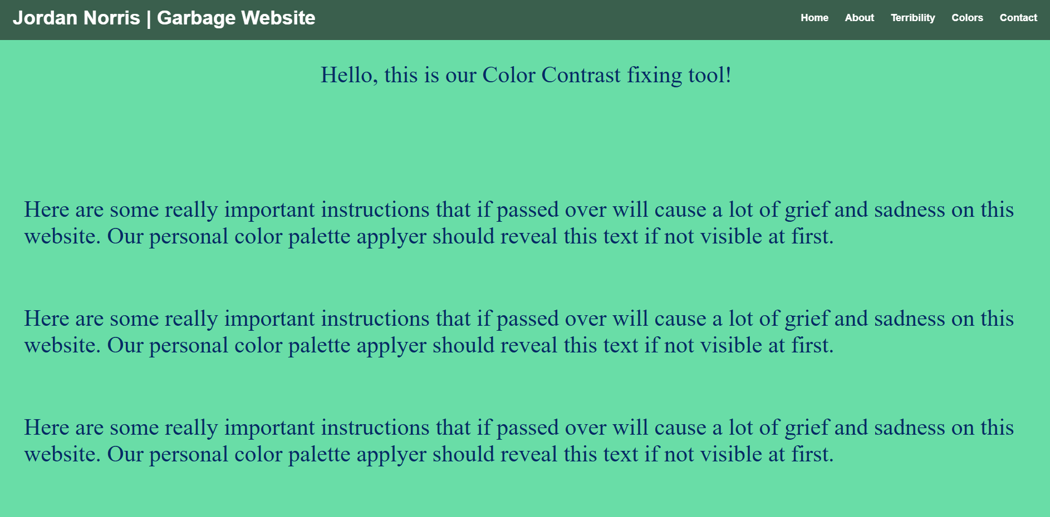
Methodology Process Design
*Protanomaly (Red) Filter applied

Slide 15
Results and Finding

Slide 16
Results/Findings
Users had an average accessibility rating of 4.22/10 before using the tool
Users had an average accessibility rating of 9.56/10 after using the tool
WAccess to identify 11 contrast errors in the bad website. Google inspection tool was used to verify WAccess’ observations.
After applying our tool with a colorblind friendly scheme, WAccess is unable to re-assess a website after load. Instead we used Google inspection tool to verify all contrast violations were gone.

Slide 17
Discussion/Analysis
The results show much improved readability and accessibility for users
This was the heart of the problem, making web pages more accessible
Most of the articles we researched about didn’t use user testing so it's hard to compare
Users were able to successfully make the web page more accessible but we got lots of feedback about how the tool was not easy to use

Slide 18
Findings/Limitations
Only tested 18 users
Users were all from Taylor in between the ages of 18-23
Only tested on one web page
We used a colorblind filter for all but one user
The results from the user who was truly colorblind confirmed the data and had similar results as the users who used the filter

Slide 19
Conclusion

Slide 20
Conclusion
Results show that the tool was successful in increasing readability and accessibility
The data was limited and biased so more testing will need to be done
Future works include making sure the browser extension can work on all dynamic web pages

Slide 21
Room for Improvement
We would like to improve the ease of use of the tool and make it easier to user for non-computer scientist
Create premade colorblind friendly schemes
Replace html element names with easy to identify names
Fix the all page application

Slide 22


References
Almeida, Rafael, and Carlos Duarte. “Analysis of Automated Contrast Checking Tools.” Proceedings of the 17th International Web for All Conference [Taipei Taiwan], 2020, pp. 1–4. DOI.org (Crossref), https://doi.org/10.1145/3371300.3383348.
Boyalakuntla, Kowndinya, et al. “WAccess -- A Web Accessibility Tool Based on WCAG 2.2, 2.1 and 2.0 Guidelines.” arXiv:2107.06799, arXiv, 21 Sept. 2021. arXiv.org, https://doi.org/10.48550/arXiv.2107.06799.
Coblis — Color Blindness Simulator – Colblindor. https://www.color-blindness.com/coblis-color-blindness-simulator/. Accessed 11 Sept. 2025.
“Content Scripts.” Chrome for Developers, https://developer.chrome.com/docs/extensions/develop/concepts/content-scripts. Accessed 17 Oct. 2025.
Corbin, Connor, et al. “Design and Development of a Web Extension to Help Facilitate the Learning of a Foreign Language.” HCI International 2020 – Late Breaking Papers: Cognition, Learning and Games, edited by Constantine Stephanidis et al., vol. 12425, Springer International Publishing, 2020, pp. 345–64. Lecture Notes in Computer Science. DOI.org (Crossref), https://doi.org/10.1007/978-3-030-60128-7_26.
Lecturer, Khujand Polytechnic Institute of Tajik Technical University named after academician M.S. Osimi, 735700 Khujand, Tajikistan, and Siddikjon Gaibullojonovich Abduganiev. “Towards Automated Web Accessibility Evaluation: A Comparative Study.” International Journal of Information Technology and Computer Science, vol. 9, no. 9, Sept. 2017, pp. 18–44. DOI.org (Crossref), https://doi.org/10.5815/ijitcs.2017.09.03.
Martins, Beatriz, and Carlos Duarte. “A Large-Scale Web Accessibility Analysis Considering Technology Adoption.” Universal Access in the Information Society, vol. 23, no. 4, Nov. 2024, pp. 1857–72. Springer Link, https://doi.org/10.1007/s10209-023-01010-0.
Muzaffar, Junaid, and Noman Mazher. “Web Accessibility Standards: Implementing WCAG Guidelines for Inclusive Design.” Pioneer Research Journal of Computing Science, vol. 1, no. 3, Sept. 2024, pp. 62–70. prjcs.com.
Nuñez, Almendra, et al. “Web Accessibility Evaluation Methods: A Systematic Review.” Design, User Experience, and Usability. Practice and Case Studies, edited by Aaron Marcus and Wentao Wang, Springer International Publishing, 2019, pp. 226–37. Springer Link, https://doi.org/10.1007/978-3-030-23535-2_17.
Sandnes, Frode Eika. “Inverse Color Contrast Checker: Automatically Suggesting Color Adjustments That Meet Contrast Requirements on the Web.” Proceedings of the 23rd International ACM SIGACCESS Conference on Computers and Accessibility [Virtual Event USA], 2021, pp. 1–4. DOI.org (Crossref), https://doi.org/10.1145/3441852.3476529.
Schiavone, Antonio Giovanni, and Fabio Paternò. “An Extensible Environment for Guideline-Based Accessibility Evaluation of Dynamic Web Applications.” Universal Access in the Information Society, vol. 14, no. 1, Mar. 2015, pp. 111–32. DOI.org (Crossref), https://doi.org/10.1007/s10209-014-0399-3.
Somé, Dolière Francis. “EmPoWeb: Empowering Web Applications with Browser Extensions.” 2019 IEEE Symposium on Security and Privacy (SP), 2019, pp. 227–45. IEEE Xplore, https://doi.org/10.1109/SP.2019.00058.
Web Content Accessibility Guidelines (WCAG) 2.2. https://www.w3.org/TR/WCAG22/#distinguishable. Accessed 11 Sept. 2025.

Slide 23


